Slide 1
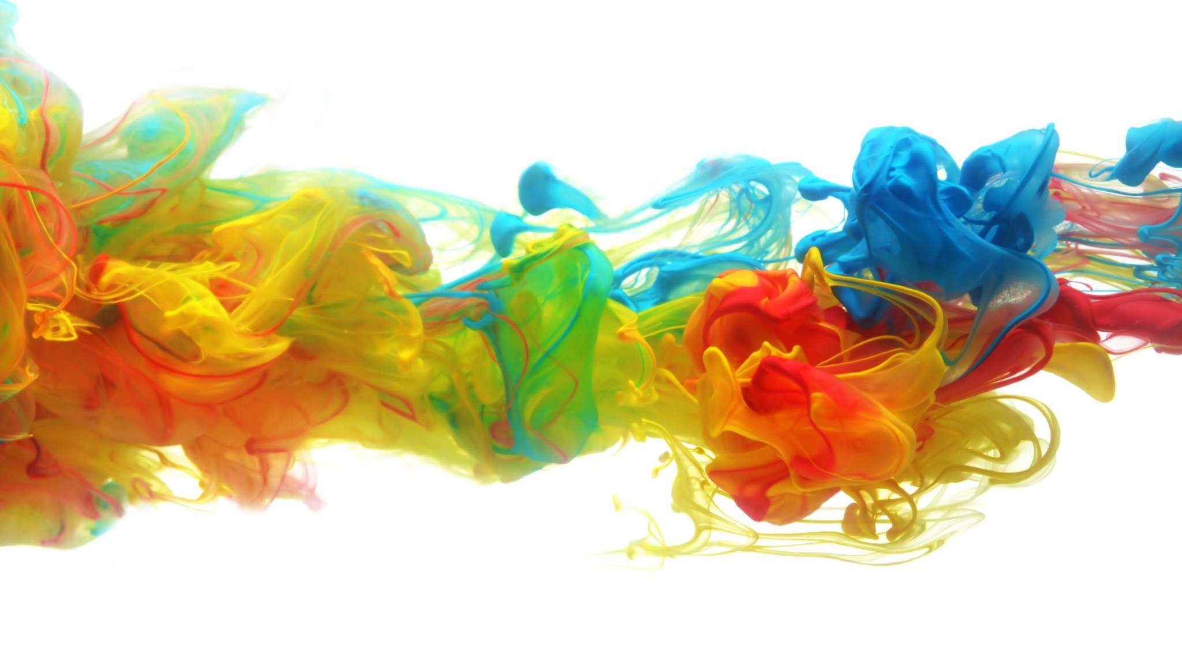
PROPOSAL
Diabetes Predictor

Slide 2
Names:
نرمين ذاكي عبد العزيز الشربيني ابو النجا
sec 8
منه الله ياسر السيد محمد غانم
Sec 8

Slide 3
Introduction
Diabetes mellitus refers to a group of diseases that affect how your body uses blood sugar (glucose). Glucose is vital to your health because it's an important source of energy for the cells that make up your muscles and tissues. It's also your brain's main source of fuel.
The underlying cause of diabetes varies by type. But, no matter what type of diabetes you have, it can lead to excess sugar in your blood. Too much sugar in your blood can lead to serious health problems.
Chronic diabetes conditions include type 1 diabetes and type 2 diabetes. Potentially reversible diabetes conditions include prediabetes and gestational diabetes. Prediabetes occurs when your blood sugar levels are higher than normal, but not high enough to be classified as diabetes. And prediabetes is often the precursor of diabetes unless appropriate measures are taken to prevent progression. Gestational diabetes occurs during pregnancy but may resolve after the baby is delivered.

Slide 4
How insulin works?
Insulin is a hormone that comes from a gland situated behind and below the stomach (pancreas).
The pancreas secretes insulin into the bloodstream.
The insulin circulates, enabling sugar to enter your cells.
Insulin lowers the amount of sugar in your bloodstream.
As your blood sugar level drops, so does the secretion of insulin from your pancreas.

Slide 5
Causes of diabetes
The amount of sugar in the blood is controlled by a hormone called insulin, which is produced by the pancreas (a gland behind the stomach).
When food is digested and enters your bloodstream, insulin moves glucose out of the blood and into cells, where it's broken down to produce energy.

Slide 6
Symptoms of diabetes
Are very thirsty
Lose weight without trying
Are very hungry
Have blurry vision
Have numb or tingling hands or feet
Feel very tired
Have very dry skin
Have sores that heal slowly
Have more infections than usual

Slide 7
Treatment
Depending on what type of diabetes you have, blood sugar monitoring, insulin and oral medications may play a role in your treatment. Eating a healthy diet, maintaining a healthy weight and participating in regular activity also are important factors in managing diabetes.

